Slide 1
LECTURE: 2
Search Strategies

Slide 2
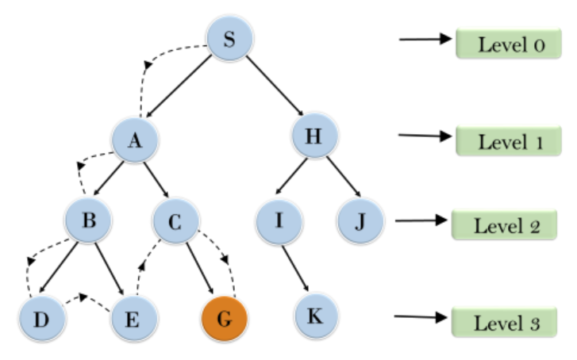
Depth-First Search (DFS)
Explores deeply before backtracking.
Uses a stack for tracking.
Time complexity: O(V+E)
Space complexity: O(V)
Not guaranteed to find optimal path.
May get stuck in infinite loops.

Slide 3
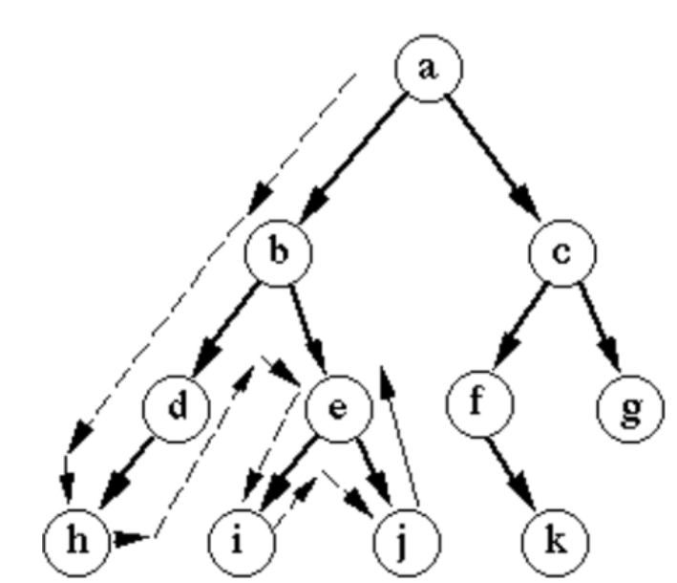
Algorithm of Depth-First Search (DFS)
Create an empty stack, push root.
While stack isn’t empty, continue process.
Pop the top node from stack.
Check if popped node is goal.
If not, push unvisited neighbors.
Repeat until goal found or stack empty.

Slide 4
Advantages of DFS:
Low memory usage
Works well with deep graphs
Simple and easy to implement
Efficient for cyclic graphs
Suitable for pathfinding in mazes
Less storage space required

Slide 5
Disadvantages of DFS:
May not find shortest path
Not guaranteed to find all solutions
High time consumption in deep paths
Fails in graphs with loops
Can get stuck in infinite paths

Slide 6
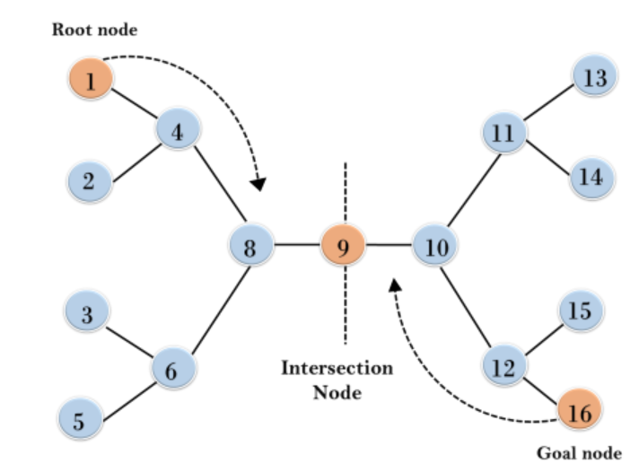
Bi-Directional Search
Searches from start and goal simultaneously
Meets in the middle for efficiency
Faster for large search spaces
Time complexity: O(b^{d/2})
Space complexity: O(b^{d/2})
Eg: Google Maps, Social networks, Gaming

Slide 7
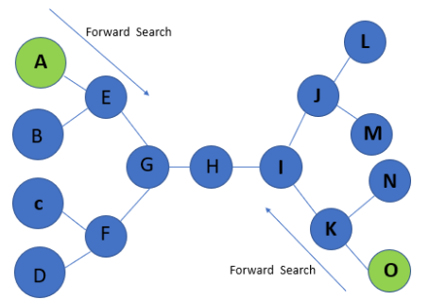
Algorithm of Bi-Directional Search
Initialize two queues for searches.
Start forward and backward searches simultaneously.
Expand nodes from both search fronts.
Check if nodes meet in middle.
If paths connect, return the solution.
Repeat until solution found or queues empty.

Slide 8
Advantages of Bi-Directional Search
Reduces search space significantly.
Faster than unidirectional search.
Efficient for large state spaces.
Can find optimal solutions.
Improves search time in complex networks.
requires less memory than traditional algorithms

Slide 9
Disadvantages of Bi-Directional Search
Requires clearly defined start and goal.
More complex to implement.
Needs synchronization between two search fronts.
Memory usage can be high in some cases.
Less effective in asymmetric graphs.
Struggles with non-uniform transition costs.

Slide 10
Quiz Time
________ is used for implementing DFS?
Queue
Stack
Heap
All of the above

Slide 11
NEXT: Discover Iterative Deepening Search
pros & cons of uninformed search methods

